Slide 1
ML SYSTEM OPTIMIZATION
Session 10

Slide 2
M3: Scale-Out Systems

Slide 3
Baseline Synchronization Protocols

Slide 4
Bulk Synchronous Parallel (BSP)
Uses barrier synchronization, where all workers must complete their computation before moving to the next step
Training proceeds in strict, synchronized iterations
Parameter servers update the global model only after receiving gradients from all workers
Ensures:
Fully consistent model updates
Equivalent behavior to single-node training
Major limitation:
Straggler problem – slow workers delay the entire system
Reduces overall system efficiency in large clusters

Slide 5
Asynchronous Parallel (ASP)
Removes synchronization barriers between workers
Workers operate independently without waiting for others
Each worker:
Fetches parameters
Computes gradients
Pushes updates immediately
Parameter servers update model continuously as gradients arrive
Advantages:
High training speed
Better resource utilization
Limitation:
Uses stale gradients (updates based on outdated parameters)
May affect convergence stability

Slide 6
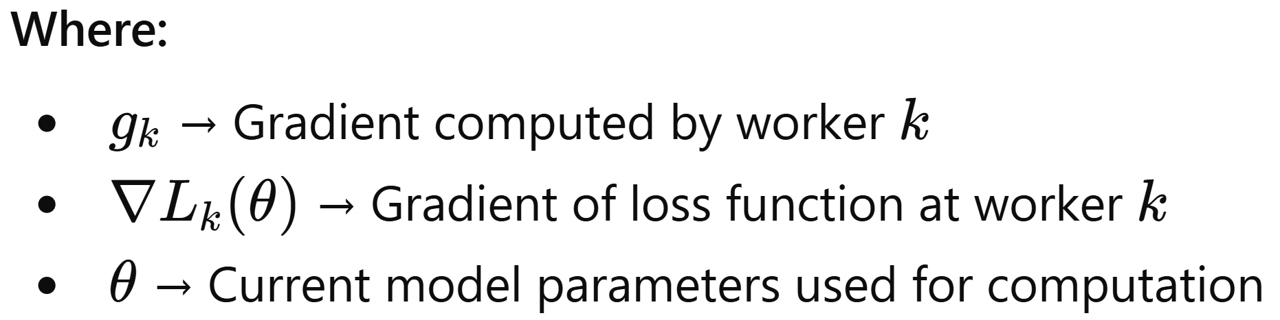
BSP Synchronization in Parameter Server Model
Parallel Gradient Computation:
Each worker k processes its local data and computes gradients independently:
g_{k}​ = ∇L_{k}​(θ)
This allows multiple workers to perform computation simultaneously, improving efficiency.
Barrier Synchronization: The parameter server waits for gradients from all K workers before proceeding. No update happens until every worker completes its computation → ensures strict synchronization.

Slide 7
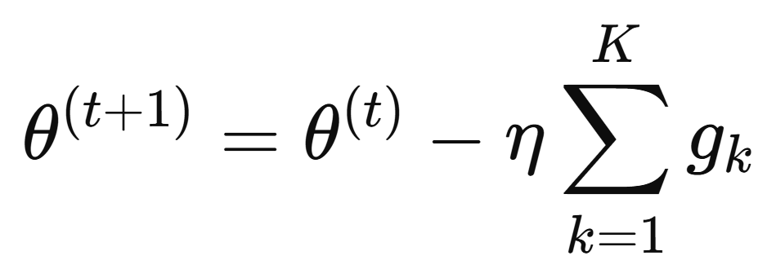
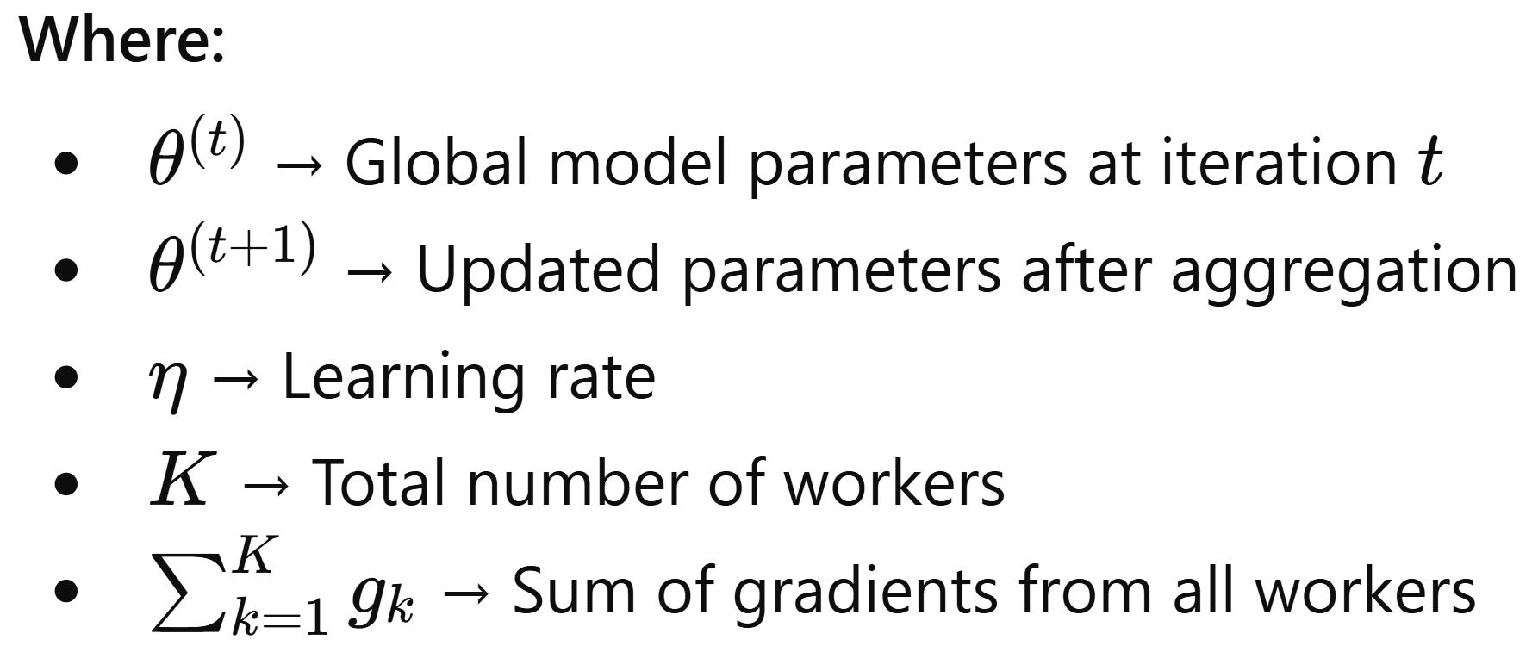
BSP Synchronization in Parameter Server Model
Global Parameter Update: Once all gradients are received, the server aggregates them and updates the model:
This guarantees that updates are based on complete and consistent information.

Slide 8
BSP Synchronization in Parameter Server Model
Consistency Across Workers: After the update, all workers receive the same updated parameter version θ^{(t+1)}. This ensures uniformity and avoids stale or inconsistent updates.
Iteration Cycle: The process repeats in synchronized steps: Compute → Wait → Aggregate → Update → Broadcast
BSP provides high model consistency and stability, but training speed may be reduced due to waiting for slower workers (stragglers).

Slide 9
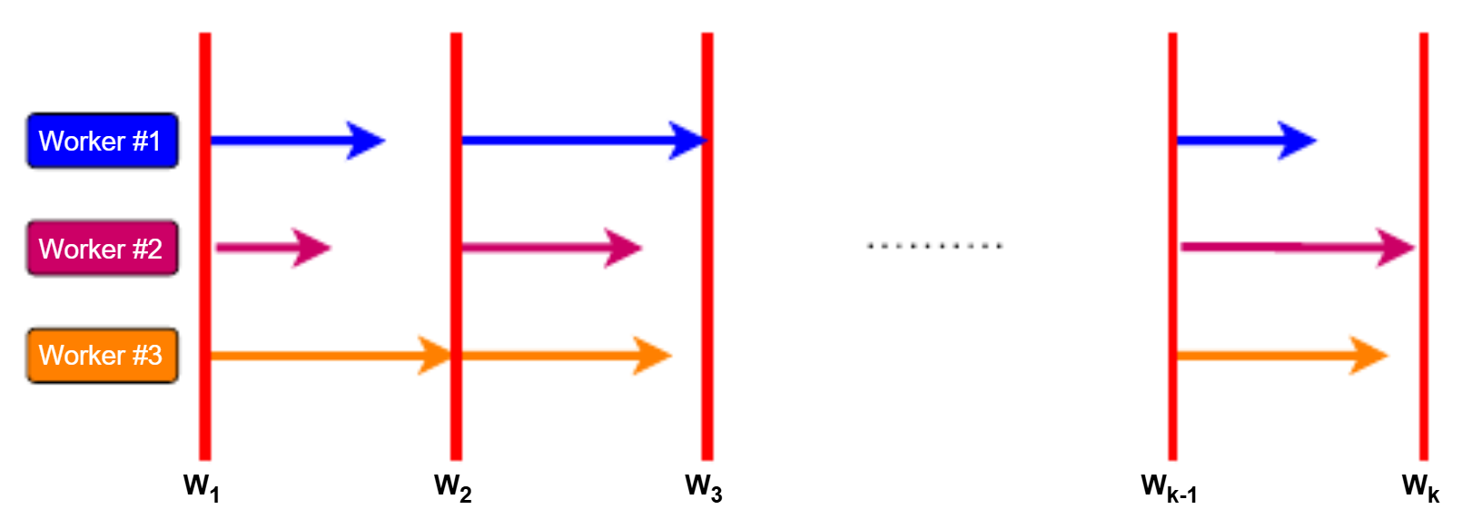
BSP Synchronization in Parameter Server Model
Multiple workers (Worker #1, #2, #3) computing in parallel across iterations W1​,W2​,W3​,…
Each worker processes its data and computes gradients simultaneously for the same iteration
The vertical red lines represent synchronization barriers. All workers must reach the barrier before moving forward
After completing computation:
Workers send gradients to the parameter server
Server waits for all workers
Then performs a global parameter update
Only after the update:
New parameters are broadcast back to all workers
Next iteration begins

Slide 10
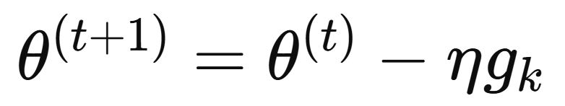
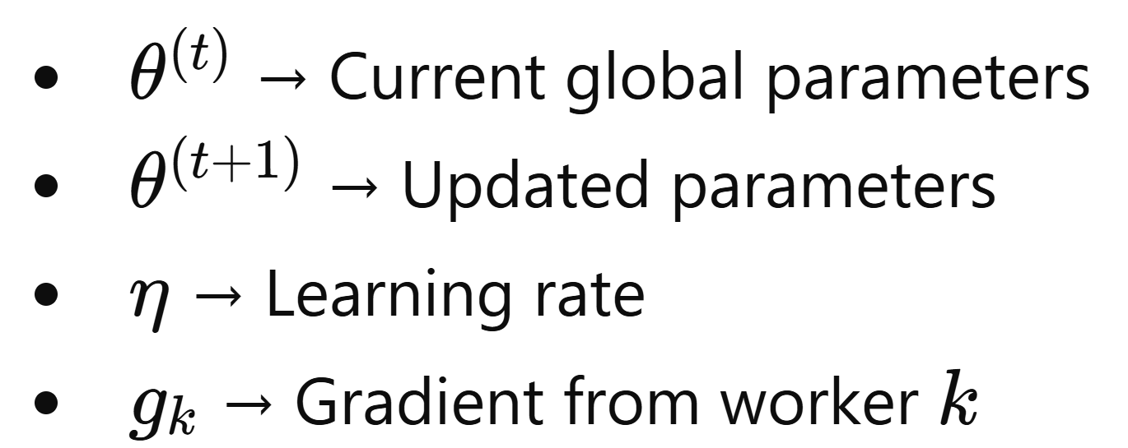
ASP Synchronization in Parameter Server Model
Independent Communication: Workers pull parameters and push gradients independently without waiting for others, enabling continuous computation.
Immediate Parameter Update: The server updates parameters as soon as it receives a gradient from any worker:

Slide 11
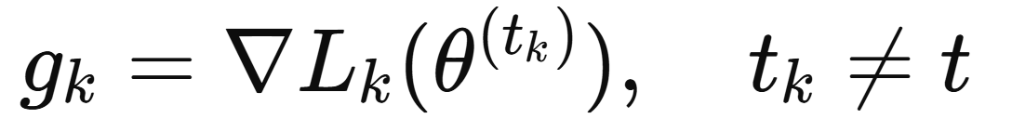
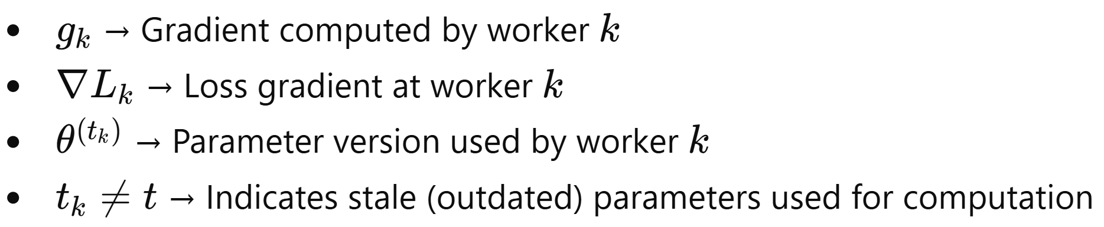
ASP Synchronization in Parameter Server Model
No Barrier Synchronization: Unlike BSP, there is no waiting for all workers, which improves training speed and resource utilization.
Stale Gradient Problem: Workers may compute gradients using older (stale) parameter versions:

Slide 12
ASP Synchronization in Parameter Server Model
Higher Throughput: Continuous updates allow faster training, especially in large-scale distributed systems.
Better Resource Utilization: Workers are never idle, leading to efficient use of compute resources
Reduced Impact of Stragglers: Slow workers do not block the system, unlike in BSP
Trade-off: Gains speed and efficiency, but may reduce convergence accuracy due to stale gradients.
Suitable for Large-Scale Systems: Works well when the number of workers is very high and synchronization cost is significant

Slide 13
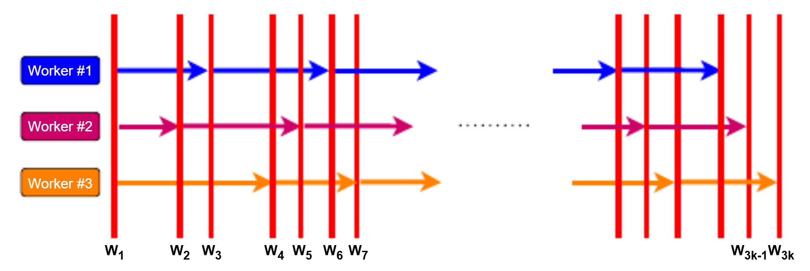
ASP Synchronization in Parameter Server Model
Multiple workers (Worker #1, #2, #3) progressing independently across iterations W1​,W2​,W3​,…
Unlike BSP, there are no strict synchronization barriers
Workers do not wait for each other
Each worker:
Pulls parameters from the server at its own time
Computes gradients
Pushes updates immediately to the server
The vertical red lines indicate parameter updates happening continuously, not in synchronized steps

Slide 14
Flexible Synchronization Models

Slide 15
Stale Synchronous Parallel (SSP)
Combines benefits of BSP and ASP
Workers proceed asynchronously without waiting for others
Staleness of updates is bounded to ensure stability
Reduces waiting time while controlling inconsistency
Staleness Condition
t_{fast​} − t_{slow}​ ≤ s
Where:
t_{fast​} = iteration number of fastest worker
t_{slow}​ = iteration number of slowest worker
s = staleness threshold, maximum allowed difference in iterations

Slide 16
Stale Synchronous Parallel (SSP)
Workers can be up to s iterations ahead of the slowest worker
Parameter servers accept updates as long as they do not exceed staleness limit
Maintains:
High training speed (like ASP)
Controlled consistency (like BSP)
Trade-off:
Large s → faster training, more stale gradients
Small s → slower training, closer to fully consistent model

Slide 17
k-Variants
k-Variants are modifications of the traditional Bulk Synchronous Parallel (BSP) protocol used in distributed training with Parameter Servers.
Purpose: Address the straggler problem in BSP by allowing the system to proceed without waiting for all workers.
Instead of full synchronization across all K workers, updates can proceed after k workers complete their computation.
Provides a flexible trade-off between:
Training speed (like asynchronous approaches)
Consistency of model updates (like BSP)
Types of k-Variants
k-BSP – Wait for k workers out of K before updating parameters.
k-batch-BSP – Wait for k mini-batches (from any workers) instead of all batches.
k-ASP – Asynchronous updates, but only use gradients from k workers per update.
k-batch-ASP – Asynchronous updates using k mini-batches per update.

Slide 18
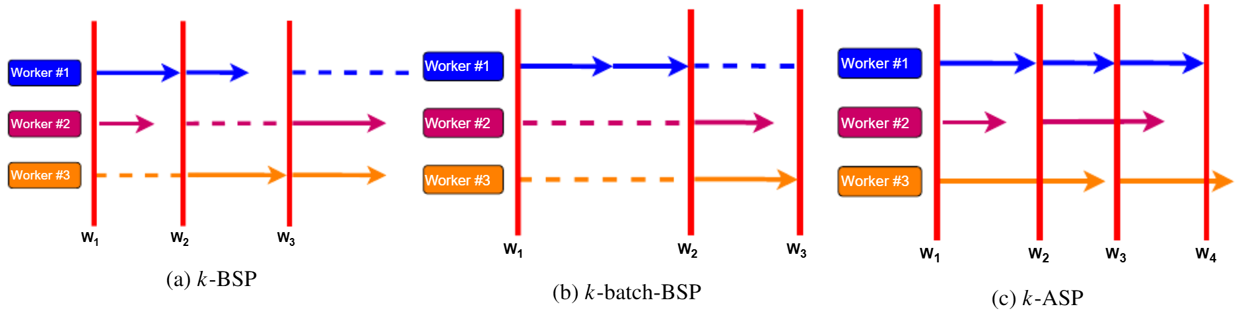
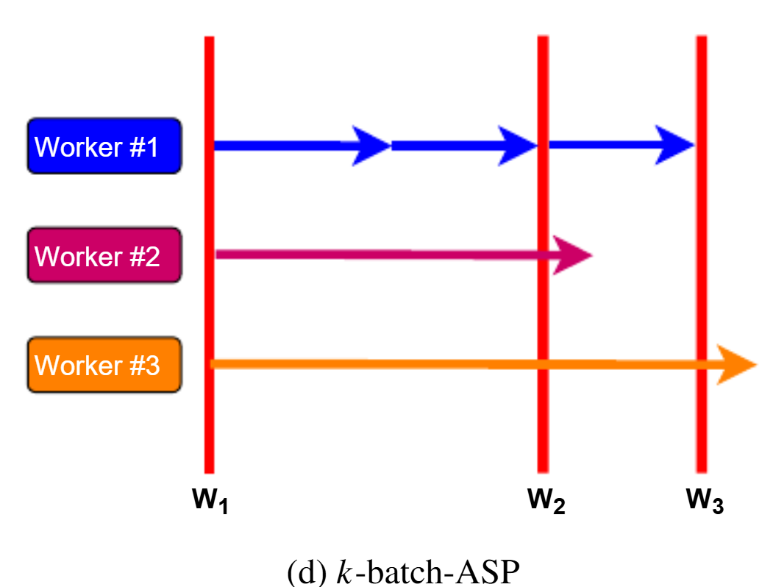
k-Variants
Fig. a, Fig. b, Fig. c and Fig. d outline the process of training under k-BSP, k-batch-BSP, k-ASP, k-batch-ASP for 3 worker with k= 2.

Slide 19
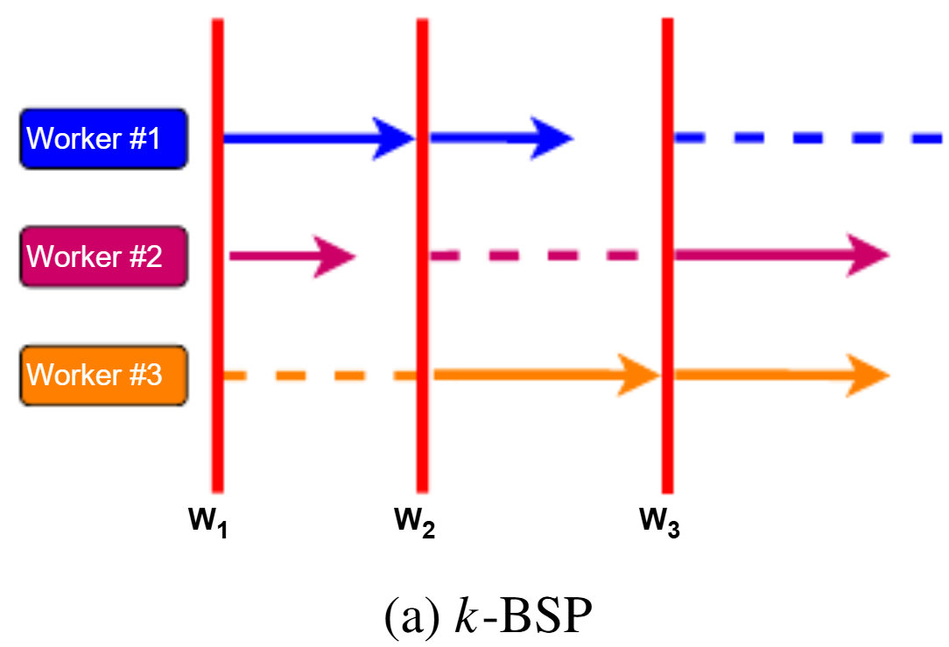
k-BSP
k-BSP: In this protocol, the parameter server collects gradients from k = 2 different workers before updating the global model. Any workers that are stalled during the iteration (for example, Worker #3 after W1 and Worker #2 after W2) are skipped, and their gradients are discarded for that iteration. This reduces the impact of slow or straggling workers while ensuring that the server can continue updating the model efficiently.

Slide 20
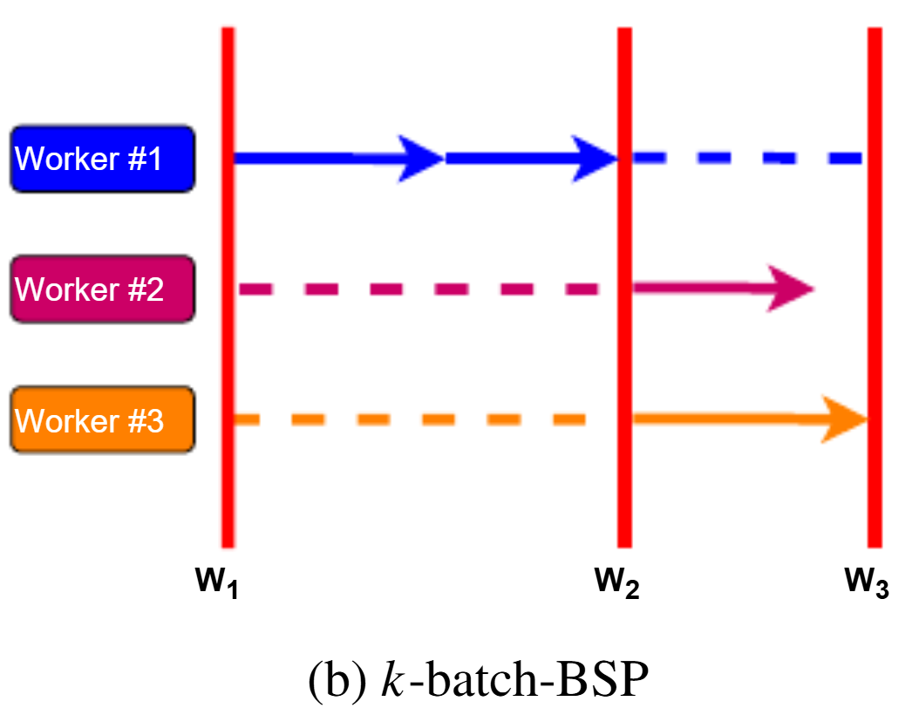
k-batch-BSP
k-batch-BSP: In this method, illustrated in Figure b, the server waits for k = 2 batch gradient updates, which may come from the same worker rather than from distinct workers. The process is similar to k-BSP, but more flexible in handling batches. For instance, after W1, two batches from Worker #1 might complete the first iteration, causing Workers #2 and #3 to be skipped for that step. In the following iteration, the previously skipped workers are allowed to contribute, ensuring all workers participate over time.

Slide 21
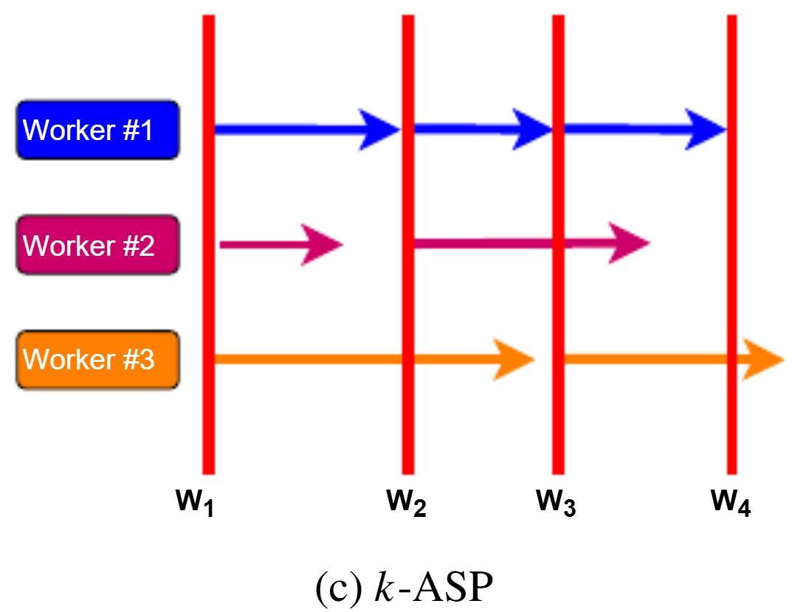
k-ASP
k-ASP: This protocol is similar to k-BSP, but with a key difference: stalled workers are not canceled. Their gradients may be included in future iterations and can contribute to completing the required k updates, as illustrated in Figure c. This approach allows delayed workers to participate without blocking the server, improving overall resource utilization while maintaining asynchronous updates.

Slide 22
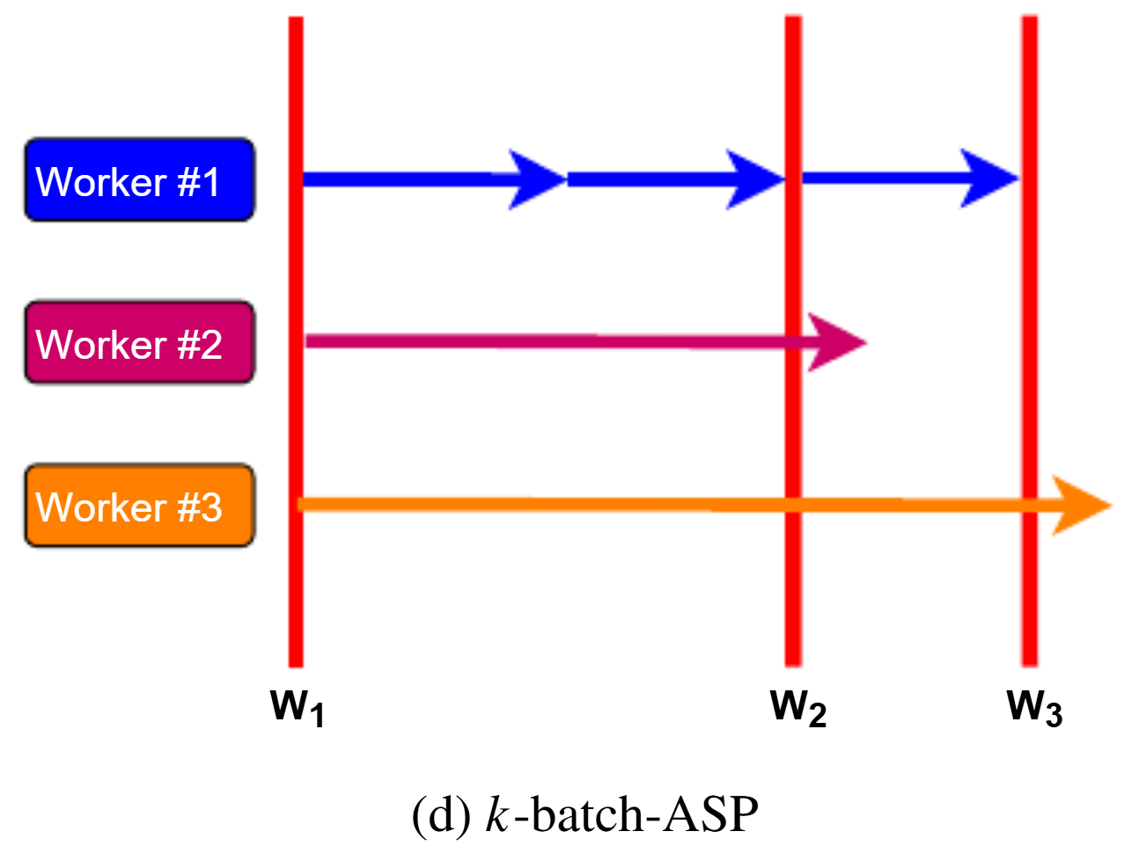
k-batch-ASP
k-batch-ASP: This protocol is equivalent to k-batch-BSP, with the key difference that stalled workers are not canceled. Their updates can be used in subsequent iterations to complete the required k batch gradients, as shown in Figure d. This approach combines the flexibility of batch-based updates with asynchronous execution, improving training efficiency without losing contributions from slower workers.

Slide 23
Network Related Optimizations in Parameter Server Architectures

Slide 24
Network-Related Optimizations
In Parameter Server (PS) systems, communication overhead is a major bottleneck.
Servers often become hotspots because multiple workers simultaneously push gradients and pull parameters.
Network optimizations aim to:
Reduce bandwidth usage
Lower latency
Reduce server load
Improve training speed and scalability
These optimizations are categorized into five key areas:
Gradient Compression
Pipelining and Overlapping
Local Aggregation and Caching
Prioritization and Scheduling
Topology and Structural Improvements

Slide 25
Gradient Compression
Reduce communication overhead between workers and parameter servers.
Maintain model accuracy and convergence while lowering network traffic.
Techniques
1. Sparsification
Send only significant gradients, ignore small ones.
Examples: Top-1%, Top-K sparsification.
Error compensation: Track discarded gradients and add them in future updates to maintain convergence.
2. Quantization
Reduce bit-precision of gradient updates.
Examples: 16-bit, 8-bit, 1-bit, ternary (TernGRAD - Uses three levels (e.g., {-1, 0, +1}) for gradient quantization to reduce communication.).
Advanced methods like MQGrad (Multi-level Quantized Gradient) use reinforcement learning to dynamically adjust bit size based on model loss.

Slide 26
Pipelining and Overlapping
Hide communication latency by performing communication in parallel with computation.
Improves resource utilization and reduces idle time in large-scale distributed training.
Techniques
1. Pipelining
Gradients from iteration i are pushed to the server while iteration i+1 is being computed.
Example: Poseidon system implements pipelining to reduce waiting.
Benefit: Communication and computation happen simultaneously, improving throughput.
2. Overlapping (Overlap Synchronous Parallel – OSP)
Uses separate threads for communication and computation.
Local training continues while parameter updates are applied in the background.
Benefit: Minimizes idle time and keeps workers busy, even during large gradient transfers.

Slide 27
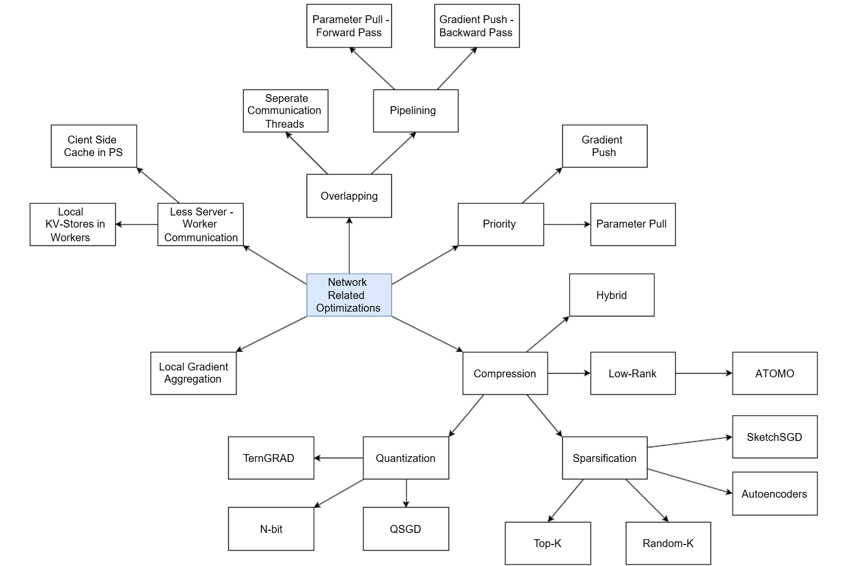
Network related optimizations for the parameter server

Slide 28
Parameter Management in Parameter Server

Slide 29
Parameter Management
In Parameter Server (PS) systems, model parameters are distributed across multiple servers instead of being stored in a single location.
As models grow larger, efficient management of parameters becomes critical for scalability and performance.
Poor parameter distribution can lead to:
Load imbalance
Network congestion
Server hotspots
Parameter management focuses on organizing and distributing parameters effectively to ensure smooth training.
Efficiently shard, store, and balance model parameters across servers to avoid bottlenecks and hotspots.

Slide 30
Parameter Storage Techniques
Basic Approach: Hash-Based Storage
Early parameter server systems used simple hashing techniques to distribute model parameters across servers
Each parameter is assigned to a server based on a hash function
Advantages:
Simple to implement
Ensures uniform distribution in theory
Limitations of Hashing
Does not consider parameter access patterns during training
In real-world workloads, access is often skewed (non-uniform)
Leads to:
Load imbalance – some servers receive more requests than others
Hotspots – frequently accessed parameters overload specific servers
Increased network congestion and latency
Example: If many workers frequently update the same parameters, the server holding them becomes a bottleneck

Slide 31
Parameter Management
Advanced Optimization Technique
Access-Pattern-Based Partitioning
Instead of randomly distributing parameters across servers, parameters are grouped based on how they are accessed during training
Parameters that are frequently updated together (co-accessed) are placed on the same parameter server
Introduced in systems like Bosen (a distributed parameter server system designed for large-scale machine learning optimization)
How it Works
Analyze access patterns of model parameters during training
Identify parameters that are commonly used together in gradient computations
Assign these related parameters to the same server
Reduces the need to fetch parameters from multiple servers

